Slide 1

VEHICLE DYNAMICS COMPONENT
Chassis & Safety | Advanced Driver Assistance Systems

Slide 2
Objective :
Estimate vehicle dynamic signals like Longitudinal velocity , Long Accel, Yaw rate and Lateral Acceleration by Offset compensation and Plausibilization.
Vehicle path prediction by providing Curvature estimation & Motion State detection
Set the DEMs/Errors in case of
a. Invalid inputs
b. Estimated signal / Variance is crossing threshold
c. Input parameters out of range
d. Input signals out of range

Slide 3
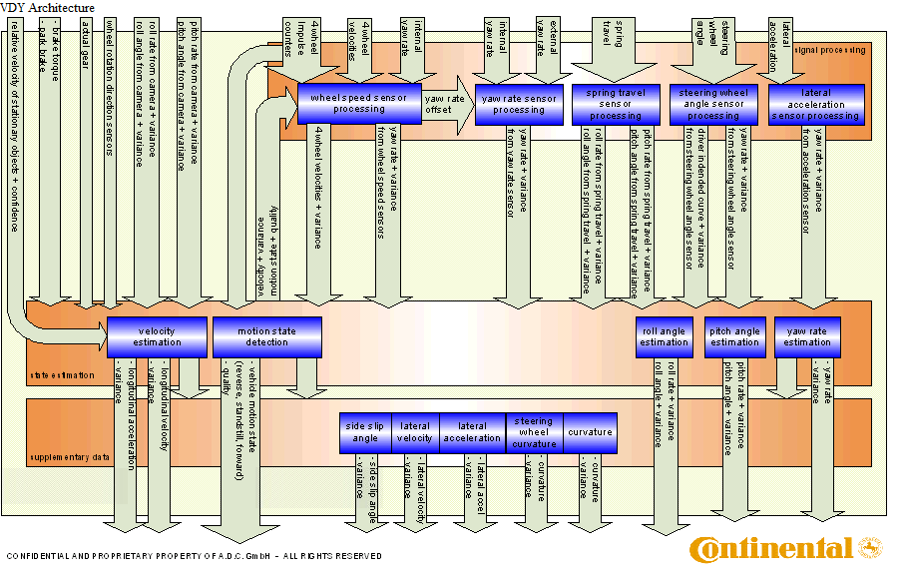
VEHICLE DYNAMICS OBSERVER COMPONENT
The objective of Vehicle Dynamic Observer are ,
a. Filtering and Offset compensation of Sensor Signals
b. Fusion of different sensor signals
c. Path Estimation
d. Set errors when data is not proper.

Slide 4
VDY Architecture
First layer "Signal processing" is preprocessing the input signals, removes offsets, and supports for each input signal a yaw rate and a corresponding variances
Second layer "State estimation" consists of three modules,:
the yaw rate fusion module using the preprocessed yaw rates,
the velocity estimation
and the motion state estimation
The Last layer "Supplementary data" estimates some additional date based on the information from the above layers, like curve, and lateral acceleration

Slide 5
VEHICLE DYNAMICS OBSERVER COMPONENT
INPUT SIGNALS
VEHICLE DYNAMIC OBSERVER
OUTPUT SIGNALS
YAW RATE
STEERING WHEEL ANGLE
LONG VELOCITY AND ACCELARATION
FOUR WHEEL VELOCITIES
FOUR WHEEL PULSE COUNTER DEVIATION
YAW RATE & Lateral Accel
FOUR WHEEL ROTATION DIRECTION
ACTUAL GEAR POSITION
MOTION STATE
PARK BRAKE STATE
BRAKE TOURQUE
VEHICLE CURVATURE
LONG ACCELERATION
STATIONARY TARGETS VELOCITY
Signal Processing:
a. Yaw Rate
b. Vehicle Velocity
INPUT PARAMETERS
Path Estimation:
a. Curvature
b. Motion State
TRACK WIDTH FRONT
VEHICLE WEIGHT
AXLE LOAD DISTR
STEERING RATIO
TRACK WIDTH REAR
UNDERSTEER GRAD
WHEEL BASE
CENTER OF GRAVITY HGT
WHEEL CIRCUMFERENCE
WHEEL TICKS PER REV
CORNER STIFFNESS

Slide 6
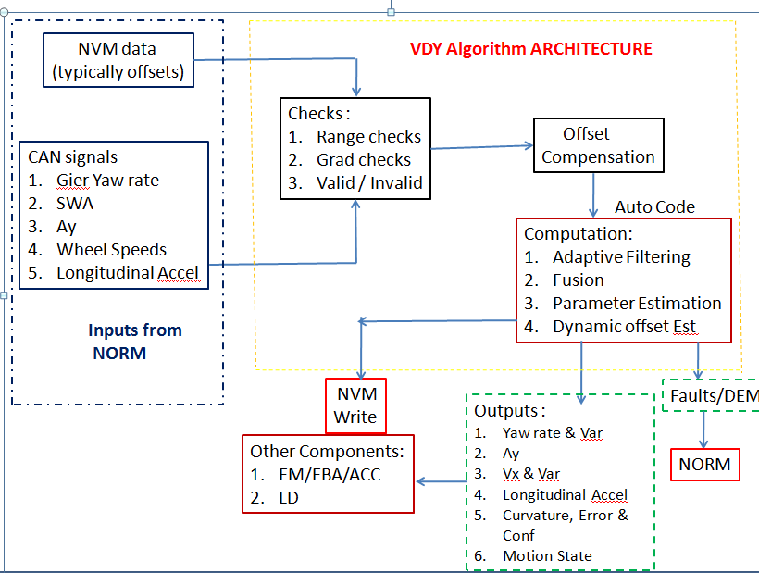
Algorithm Architecture
Co-ordinate system:
Autosar Compliant
Defined w.r.t. COG
Left Turn,
SWA +ve
Yaw Rate +ve
Lateral Acc +ve
X
Front Axle
Y
Rear Axle
4. Z +ve up

Slide 7
INPUT SIGNAL PRE-PROCESSING
1. INPUT SIGNAL MONITOR
Magnitude Limiter
Wheel Speeds +/- 115 m/sec
Yaw Rate +/- 150 deg/sec
Long Accel +/- 10 m/sec2
Lateral Accel - +/10 m/sec2
SWA +/- 90 *SR
Input Signal
Rate Limiter
Wheel Speeds +/- 10 m/sec
Yaw Rate +/- 6 deg/sec
Long Accel +/- 2.5 m/sec2
Lateral Accel - +/2.5 m/sec2
SWA +/- 6 deg/sec
Input Signal
Validity checks
Wait for 3 VDY cycles
To check whether input is INVALID
Then set the state as INVALID
Input Signal

Slide 8
Inter Connection of Different VDY processing modules

Slide 9
INPUT SIGNAL PRE-PROCESSING
2.OFFSET COMPENSATION
YAW RATE Offset Compensation
EXT GIER YAW RATE +OFFSET
OFFSET COMPENSATED GIER YAW RATE
LAT ACCEL Offset Compensation
LAT ACCEL +OFFSET
OFFSET COMPENSATED LAT ACCEL
WHEEL SPEED
Offset Compensation
WHEEL SPEEDS +OFFSET
OFFSET COMPENSATED WHEEL SPEEDS
STEERING WHEEL ANGLE
Offset Compensation
STEERING WHEEL ANGLE+OFFSET
OFFSET COMPENSATED STEERING WHEEL ANGLE

Slide 10
Steering Wheel Angle Offset
When the vehicle is moving at certain velocity
If driver provides SWA as an input
Steering column rotation
sensed by SWA sensor
Steer Ratio (Rack and Pinion)
Front Wheel Angle
Angular rotation about z-axis
is sensed by Gyro
Vehicle develops Yaw rate
Lateral Acceleration is experienced
by the vehicle
Lateral Accelerometer

Slide 11
Fast Steer Wheel Angle offset computation:
Learning Conditions :
a. NVM is cleared / New Sensor (Learnt State is zero)
b When the Wheel Speed Difference (FL – FR & RL – RR) is less than
0.6 m/sec and the vehicle velocity > 5 m/sec
c. SWA < 30 deg
d. Collect the samples till distance criteria (> 250 m) is met.
Compute the average of collected samples.
Method of computation :
1. Compute difference between Yaw rate estimated from SWA and
offset compensated Gyro Yaw rate. (Note : Estimated values are
outputs of KFs)
2. SWA Offset = Difference * SR * (L + EG * V_{x}²)/V_{x}
3. Set the Learnt State to 1

Slide 12
SWA Offset Overview
Learning distance Criteria :
Fast steer wheel angle --- 250 cycles
First Learning --- 25 Km
Second Learning --- 30 Km
Third Learning -- - 35 km
Fourth Learning ---- 40 Km
Fifth Learning ---- 40 km
Sixth Learning ----- 50 Km
(learned but not confirmed)
(learned and confirmed once)
(learned and confirmed twice)
Reset Criteria:
If there is a difference more than 0.5 deg between previously learnt value and the latest value then update that value with the latest value and set the state to 4.
Impact of SWA offset :
It will have impact on curvature computation
Errors associated with SWA offset :
Out of Range SWA offset error (SwaOffsRg)

Slide 13
Next Level SWA offset Learning
Learning conditions : (Straight drive)
Velocity > 10 m/sec, Wheel Speed Difference (FL – FR & RL – RR) is less than 0.3 m/sec
Build Histogram : Histogram is filled based on direct SWA measurements
Lateral Acceleration is more than 1.8 m/sec2
Reset histogram.
W15
W5
W1
-14 deg
14 deg
Check enough number of samples are collected based on distance criteria.
Computed median, once enough number of samples are collected.

Slide 14
SWA Offset Overview
Learning distance Criteria :
Fast steer wheel angle --- 250 cycles
First Learning --- 25 Km
Second Learning --- 30 Km
Third Learning -- - 35 km
Fourth Learning ---- 40 Km
Fifth Learning ---- 40 km
Sixth Learning ----- 50 Km
(learned but not confirmed)
(learned and confirmed once)
(learned and confirmed twice)
Reset Criteria:
If there is a difference more than 0.5 deg between previously learnt value and the latest value then update that value with the latest value and set the state to 4.
Impact of SWA offset :
It will have impact on curvature computation
Errors associated with SWA offset :
Out of Range SWA offset error (SwaOffsRg)

Slide 15
YAW RATE OFFSET
When the vehicle is detected to be in stand still state, yaw rate stand still offset is estimated
as mean value of 30 cycles for the first time. Later on it is computed as a mean of 15 cycles.
Quality of yaw rate offset determines the last estimated yaw rate offset will be considered for
compensation or not.
The allowed learning is 4 deg/sec in a stand still cycle.
Turn Table Detection :
When the motion state detected is stand still and if the measured yaw rate is more than
7 deg/sec
Fast Stand Still : When the quality is less than 0.75 (approximately)
Dynamic Yaw rate offset : (High way driving)
a. Long Vel >=14 m/sec, Lateral Accel <=3.5 m/sec2, Long Accel <= 2.0 m/sec2, Yaw Rate Front and Rear Diffe <=0.02
b. Initial value of the dynamic yaw rate offset is Stand Still offset and its starts learning on top of that. The learning rate is not
allowed to go more than 0.002 in 500 cycles.

Slide 16
Lateral Accel Offset Learning (Similar lines of SWA offset)
Learning conditions : (Straight drive)
Velocity > 10 m/sec, Wheel Speed Difference (FL – FR & RL – RR) is less than 0.3 m/sec.
Build Histogram : Histogram is filled based on direct SWA measurements
(Distance Computation)
W15
W5
W1
-2.5 m/sec2
2.5 m/sec2
Check enough number of samples are collected based on distance criteria.
Compute median, once enough number of samples are collected.

Slide 17
Lateral Acceleration Offset
Learning distance Criteria :
First Learning --- 20 Km
Second Learning --- 25 Km
Third Learning -- - 30 km
Fourth Learning ---- 30 Km
Reset Criteria:
Lateral Acceleration more than 1.8 m/sec2
Errors associated with SWA offset :
Out of Range lateral acceleration offset error (AyOffsRg)

Slide 18
YAW RATE ESTIMATION
GYE
KALMAN FILTER
YAW RATE
+VARIANCE
OFFSET COMPENSATED GIER YAW RATE
YE
KALMAN FILTER
SYE
KALMAN FILTER
STEERING WHEEL YAW RATE
+VARIANCE
OFFSET COMPENSATED STEERING WHEEL ANGEL
MERGED YAW RATE +VARIANCE
AYE
KALMAN FILTER
LAT ACCEL YAW RATE
+VARIANCE
OFFSET COMPENSATED LATERAL ACCELERATION
WYE
KALMAN FILTER
WHEEL SPD YAW RATE
+VARIANCE
OFFSET COMPENSATED
4 WHEEL VELOCITIES

Slide 19
VELOCITY ESTIMATION
OFF COMP WHEEL VELOCITY FRONT LEFT
MERGED VELOCITY +VARIANCE
CORRECETD VELOCITY VARIANCE
OFF COMP WHEEL VELOCITY FRONT RIGHT
VELOCITY CORRECTION
OFF COMP WHEEL VELOCITY REAR LEFT
MERGING KALMAN FILTER
MERGED ACCEL +VARIANCE
OFF COMP WHEEL VELOCITY REAR RIGHT
RELAVTIVE VELOCITY+ VAR FROM STATIONARY TARGETS

Slide 20
CF computation
Build histogram from the ratio of speeds (CF).
Compute median from histogram to compute CF statistically
Range of CF = 0.7 to 1.3

Slide 21
VDY CURVE ESTIMATION
VDY Input
VDY Internal Data
VDY Output
Curve Estimation using Kalman Filter
External Velocity
Vehicle Velocity
Steering wheel Angle
Steering wheel Curve
Vehicle Curve/Lane Radius
Steering wheel Angle
Wheel Speeds
Gier Yaw Rate
Yaw Rate
Yaw Rate Curve
Lateral Acceleration

Slide 22
MOTION STATE ESTIMATION
WHEEL PULSE COUNTER PROCESSING
VEHICLE VELOCITY PROCESSING
BAYES NET
VEHICLE MOTION STATE
-FORWARD
-REVERSE
-STANDSTIL
-MOVING
YAW RATE PROCESSING
WHEEL DIRECTION PROCESSING
BRAKE TORQUE
PROCESSING
PARK BRAKE
PROCESSING
GEAR SHIFT
PROCESSING

Slide 23
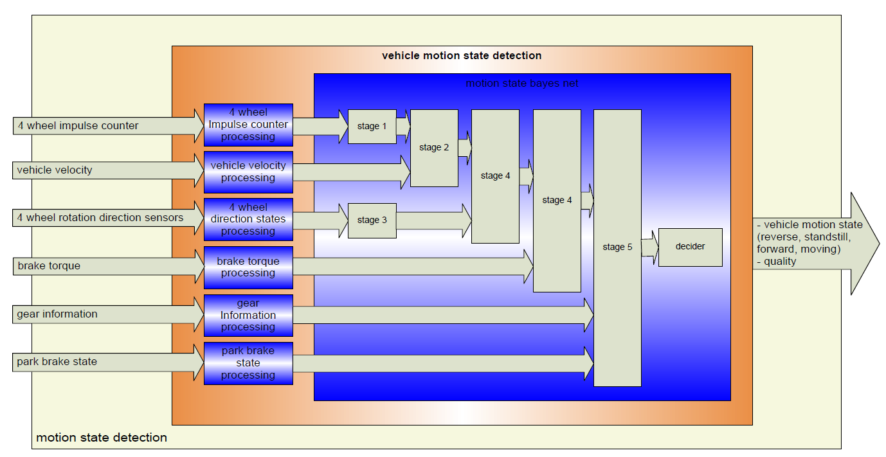
Mtn State Detection

Slide 24
VDY Outputs
Yaw Rate
Lateral Acceleration
Motion State
Curvature
Yaw rate
Yaw rate variance
Yaw rate Offset
Yaw rate Quality
Lateral Acceleration
Lateral Acceleration offset
Lateral Acceleration Quality
Curvature
Driver Intended curvature
Motion State
Motion State Confidence
Long Velocity & Accel
SWA
Uncorrected Veh Velocity
Corrected Veh Velocity
Corrected Velocity Variance
Vehicle Acceleration
Quality of Velocity
Quality of Accel
Offset compensated SWA
SWA offset

Slide 25
VDY-MTS simulation (Interface)
MTS
ECU-CODE
S
I
M
A
D
A
P
T
E
R
NVM
interface
R T E
Simulation
Results
RECORDING
DEVICE
R
T
E
R
T
E
VISUAL
PLOTS
VDY-Algo
Input
interface
Output
interface
R T E
Parameter
interface

Slide 26
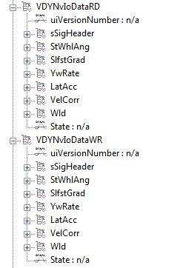
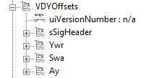
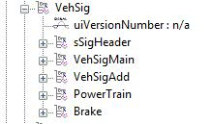
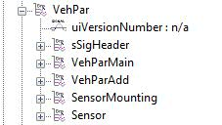
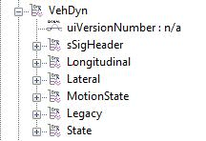
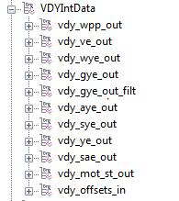
VDY-Structures in MTS

Slide 27
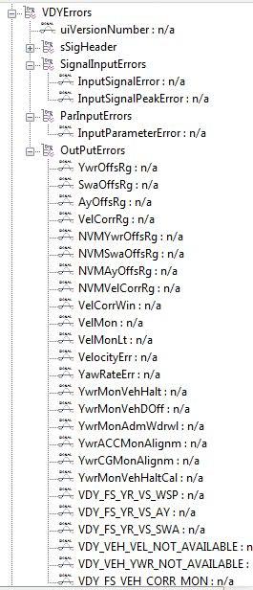
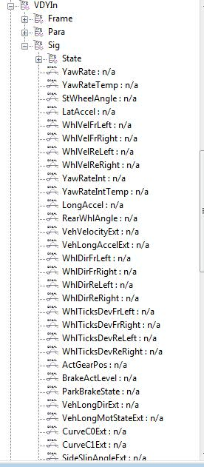
VDY-Structures in MTS

Slide 28
Thank you

